Slide 1
Engineering Design Challenge
Find your team

Slide 2
Engineering Design Challenge
Why a Team Design Challenge?
  Learn Engineering Design Process
  Work with a team of other talented TAME students
  It’s really fun!

Slide 3
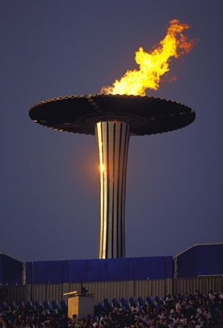
Engineering Design Challenge
Today’s challenge:
Build a tower to support the
Olympic flame.

Slide 4
Engineering Design Challenge
Congratulations on making it to the Olympic Games. A torch was designed to burn for the duration of the games. Unfortunately, recent weather destroyed the supporting tower. Your mission today is to build a replacement support using the components salvaged from the original.
You will need to use creative engineering approaches and weigh all trade-offs to solve your challenge.

Slide 5
Engineering Design Challenge
Primary objectives:
Height
Strength
Stability

Slide 6
Engineering Design Challenge
You will have 45 minutes to design, build and test your project.
Suggested schedule:
  Design – 10 minutes
  Build – 20 minutes
  Test and refine – 15 minutes

Slide 7
Engineering Design Challenge
Points are awarded for height of your tower.
Points will be awarded for each weight you tower supports.
Win by scoring the highest number of points.
Additional awards will be given for creative designs.

Slide 8
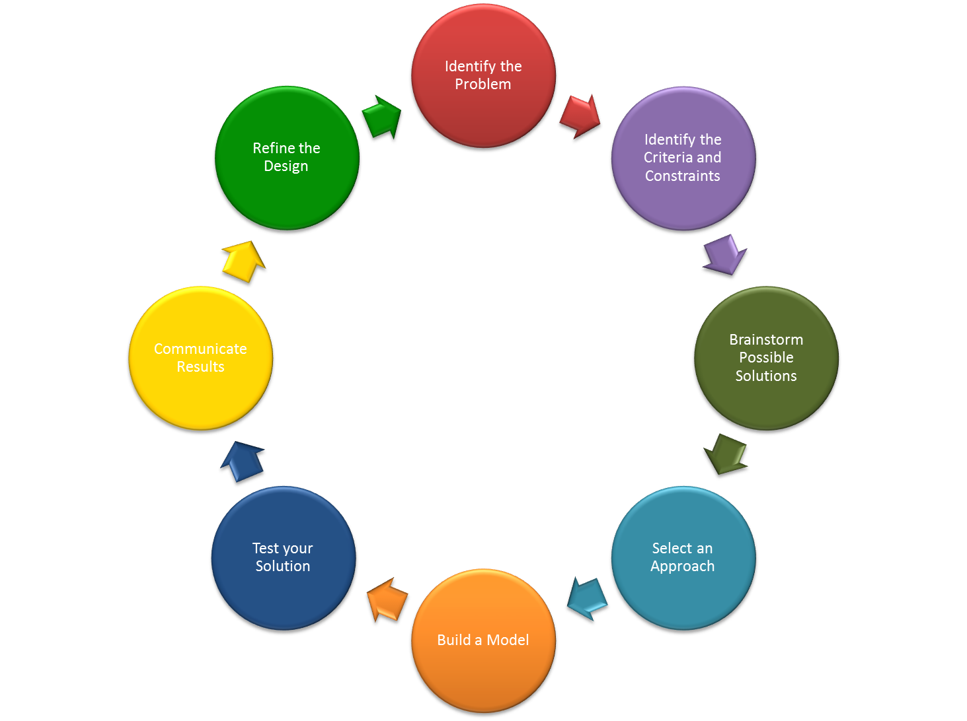
Engineering Design Challenge
Notes:
It is critical that you use the engineering design process to develop your tower support. Teams that invest the time into careful analysis, planning and testing tend to be more successful.

Slide 9
Engineering Design Challenge
Each team will be given the same set of instructions and supplies.
Be sure to check your supplies immediately since any missing supplies must be replaced in the first five minutes of the challenge.
Read all instructions carefully before beginning the challenge.

Slide 10
Engineering Design Challenge
Assign roles for each team member:
  Project Manager
  Design Engineer
  Structural Engineer
  Materials Engineer
  Test Engineer

Slide 11
Engineering Design Challenge
Design constraints:
The container to hold the weights may not be modified in any way.
The base of the container must be a minimum of 8 inches off the ground.
No parts of the tower can be attached (via tape, adhesive, etc.) to the floor, walls or any external structure. The tower must be able to stand on its own throughout the duration of judging.
ONLY the supplies specified in the materials list may be utilized as part of the tower.

Slide 12
Engineering Design Challenge
Regulations for judging:
Judges will measure the height of the tower from the table/floor to the lowest point of the container.
The Test Engineer will add weights to the inside of the container, one at a time. During judging, the Test Engineer may NOT touch any part of the tower.
Weights will continue to be added until the integrity of the tower has been compromised.

Slide 13
Engineering Design Challenge
The tower has been compromised if:
  the container falls off the tower
  any weights fall out of the container or
  the height of the tower is reduced by an inch or more.
The number of weights in the container just before the tower collapsed will be counted as the maximum capacity of the tower and recorded on the scoring sheet.
Team members may watch the judging runs from a distance, as specified by the judges.

Slide 14
Engineering Design Challenge
TASK | SCORE
Base of the container is 8” high | 10
Each weight added to tower before it is compromised | 5 points per weight
Creative/innovative approach | 1-7
From 12 and 15.75 inches | 10 bonus points
From 16 and 19.75 inches | 20 bonus points
From 20 and 23.75 inches | 30 bonus points
From 24 to 27.75 inches | 40 bonus points
Above 28 inches | 60 bonus points
TOTAL SCORE | Sum of above

Slide 15
Engineering Design Challenge
Suggestions
Spend about 10 minutes planning and drawing your design before building.
Test your tower as you build to make sure it works.
Divide and conquer – allow team members to work on different parts of the tower.
Be creative. There are many different ways to build a winning structure, so think about different approaches you could take.

Slide 16
Engineering Design Challenge
Some quick hints:
Study all of your supplies and think about multiple ways to use them.
Determine how you will build a strong structure.
Use the Engineering Process to design, build and test your tower.

Slide 17
Engineering Design Challenge
Read the instructions carefully, follow them precisely. Read what the rules state and base your decisions on the rules. If the rules do not state that you cannot do something, then you may do it, as long as it is safe and not destructive.

Slide 18
Engineering Design Challenge
Listen carefully when you hear the air horn in the work area. Instructions will be given at that time.

Slide 19
Engineering Design Challenge
You are responsible for cleaning up your work area. You will not be judged until your area is clean and all trash has been thrown out.

Slide 20
Engineering Design Challenge
When you leave the auditorium, stay with your team and find the table where you will be working. You may not touch any of the items on your table until our head judges give you the signal to start.

Slide 21
Engineering Design Challenge
Wait until your team number is called to leave the auditorium.
Good luck!

