Slide 1
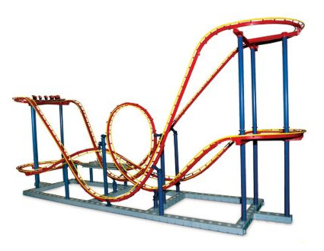

Engineering Design Challenge
BB Coaster Engineering Design Challenge
Engineer a 3D maze made of straws to serve as a rollercoaster for a metal BB.

Slide 2
Engineering Design Challenge
Today’s Challenge:
Design and build a 3D maze of straws through which a metal BB must travel. The BB should complete the track successfully and land into a cup.
Your design will be judged by the success of the metal BB completing the track, amount of time to run the track, height, length, additional loops, and angles of the track.

Slide 3
BB Coaster
Each team will have a spoon straw and a paper cup. The track must start with the spoon straw and end in the cup.
All support for the BB-coaster track must be attached to the baseboard.
The baseboard can not be manipulated. All other materials may be manipulated.
Only materials that are provided may be used for construction.
Once you have dropped the BB into the straw, you may not touch or interact with the BB-coaster in any way.

Slide 4
Scoring
Total Score = Track is completed
+ BB stays in cup + Time for BB to finish
+ Height of track
+ Length of track
+ # of turns ≥ 90˚ angle
+ # of vertical loops

Slide 5
Scoring
Points will be awarded based on the best run out of three.
You will only be scored on the portion of the track that the BB traverses.
If the BB never completes a full run and stops after traveling half the track, only half the track length, the maximum height to that point, the number of turns and loops to that point will be scored.
Height and length will be scored to the nearest tenth of a centimeter.

Slide 6
Scoring Summary
Work to create a BB-coaster that reaches new heights and lengths, twists and turns, while keeping a smooth ride.

Slide 7
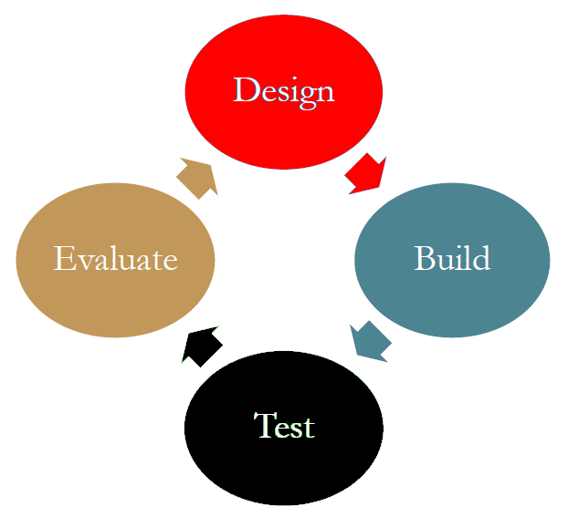
Engineering Design Process

Slide 8
Project Plan
You will have 45 minutes to design, build and test your project.
Suggested schedule:
  Discuss and design: 15 minutes
  Build: 20 minutes
  Test and refine: 10 minutes

Slide 9
Project Plan
Divide and conquer, allow team members to work on different parts of the design.
Be creative. There are many different ways to build a working delivery system.
Follow the Engineering Design Process as you work on this challenge.

Slide 10
Teams and Supplies
Each team is given the same set of instructions and supplies.
Be sure to check your supplies immediately since any missing supplies must be replaced in the first five minutes of the challenge.
Read all instructions carefully before beginning the challenge.

Slide 11
Student Roles
Each team member has a role:
Project Manager
Lead Design Engineer
Lead Materials Engineer
Lead Civil Engineer
Lead Test Engineer

Slide 12
Student Roles
The Project Manager will lead the team and keep track of all requirements and documentation.
The Lead Design Engineer will lead the design phase to maximize the amount of points awarded.
The Lead Materials Engineer will lead the resources to ensure all materials are used in the best possible manner.
The Lead Civil Engineer will lead the construction phase to maintain stability.
The Lead Test Engineer will lead the presentation during the testing phase.

Slide 13
Engineering Design Challenge
Read the instructions carefully, follow them precisely.
Read what the rules state and base your decisions on the rules.
If the rules do not state that you cannot do something, then you may do it, as long as it is safe and not destructive.
You are responsible for cleaning up your work area.

Slide 14
Engineering Design Challenge
Your teams earns points for the length of time your BB takes to travel through your coaster. What can your team do to maximize this time?

Slide 15
Engineering Design Challenge – Divisional Competition 2020
Wait until you have completed the judging phase and your area is clean before moving forward.
Good Luck!

